Slide 1



REACT
A open-source front end JS library
Presented By
Rifa Azad
ID: 2022-1-60-265

Slide 2

WHAT IS REACT?
React is a JavaScript library used to build dynamic and interactive user interfaces.
Created by Facebook in 2011
React
Angular
Vue

Slide 3
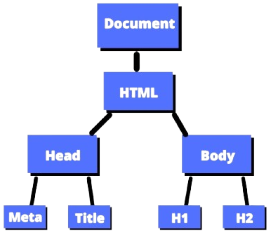
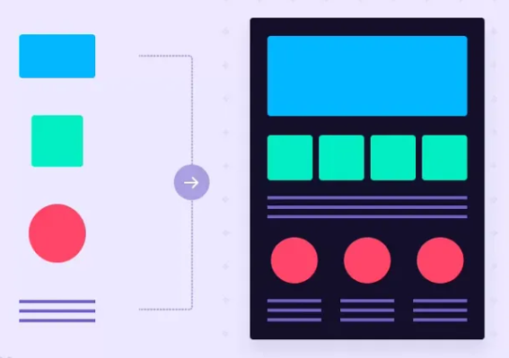
Vanilla Javascript
const btn = document.querySelector('#btn’);
btn.addEventListener('click', () => {
const div = document.querySelector( "#div");
div.style.display = 'none';
});

Slide 4
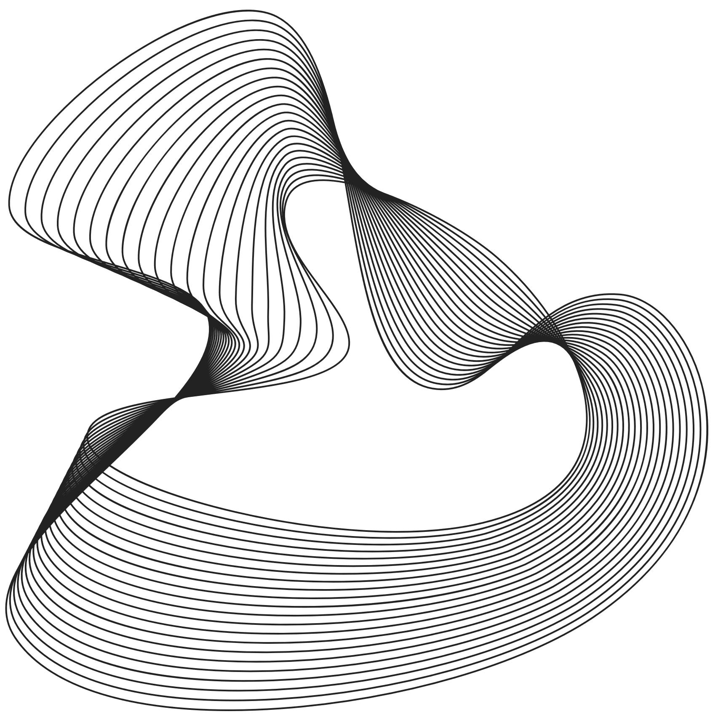
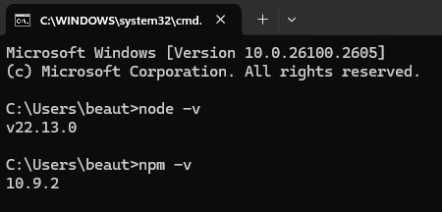
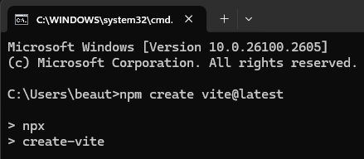
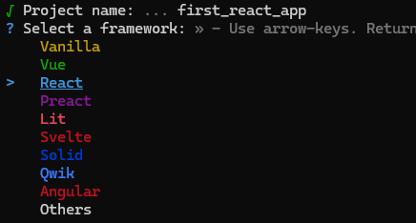
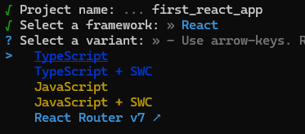
Setup React Enviroment

Slide 5
Setup React Enviroment

Slide 6
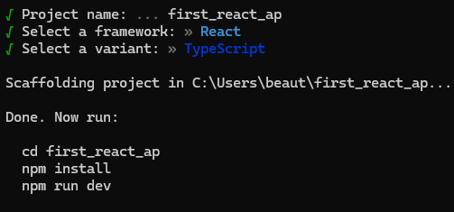
Setup React Enviroment

Slide 7
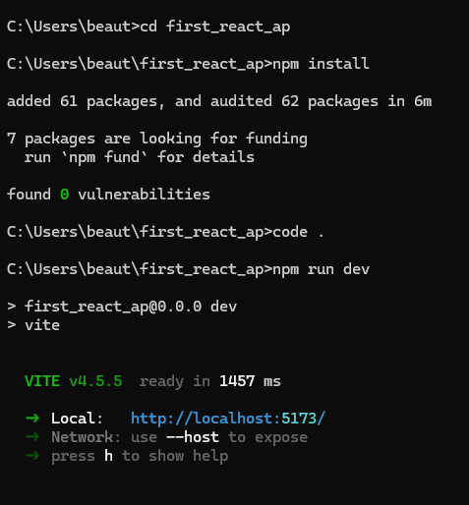
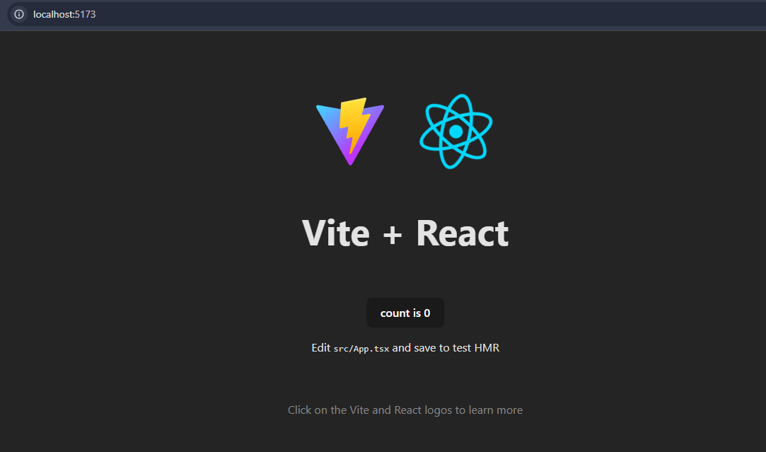
Setup React Enviroment

Slide 8
Setup React Enviroment

Slide 9
Setup React Enviroment

Slide 10
Setup React Enviroment

Slide 11
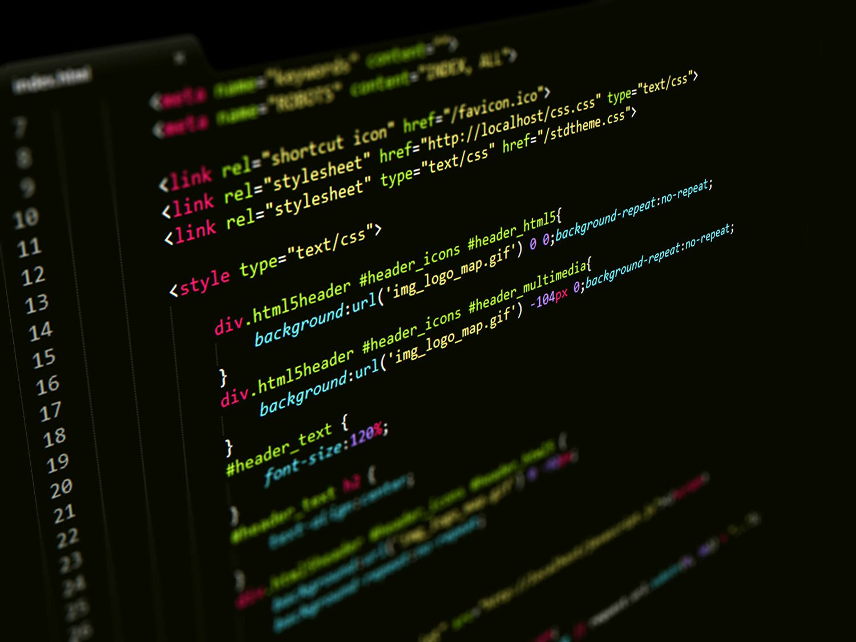
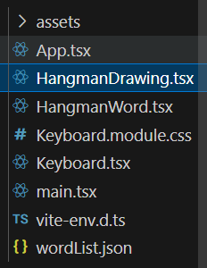
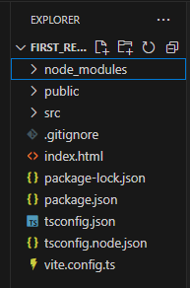

Slide 12

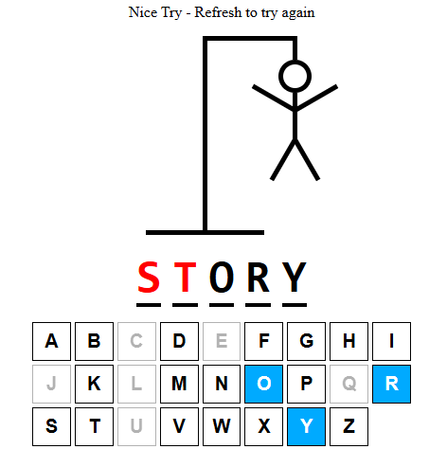
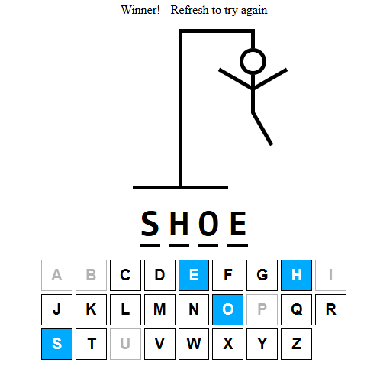

Slide 13




Features of React
Component-based
React allows you to build reusable components that manage their own state.
Declarative
React makes it easy to create interactive UIs by updating and rendering only the components that need to change.
Server rendering
React can render on the server using Node.

Slide 14






WHY REACT
Reusable Components
Efficient Debugging
Virtual DOM
Open Source
Ease of Use

Slide 15




Conclusion
React is a powerful JavaScript library designed to build dynamic and interactive user interfaces efficiently. React's approach not only streamlines development but also ensures scalability and maintainability, making it a go-to choice for modern web applications.
Thank you

